Slide 1
Weaving
A textile art

Slide 2
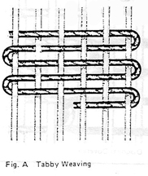
What is weaving?
A method of creating textiles, or fabric
Involves the use of two separate sets of threads or yarns that are interlaced at right angles to form cloth:
The way the threads interlace is called the weave.
Warp--
longitudinal thread
Weft --
filler thread (horizontal)

Slide 3
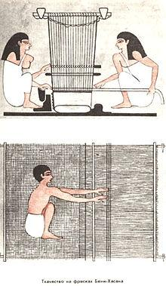
A brief history...
Weaving has been used since prehistoric times.
Fragments of woven cloth have been found in ancient graves around the world and are as much as 12,000 years old!
Evidence shows that most used looms of some kind
Image of ancient Egyptian women weaving, as depicted on a tomb at Beni Hassan (wikipedia.com)

Slide 4
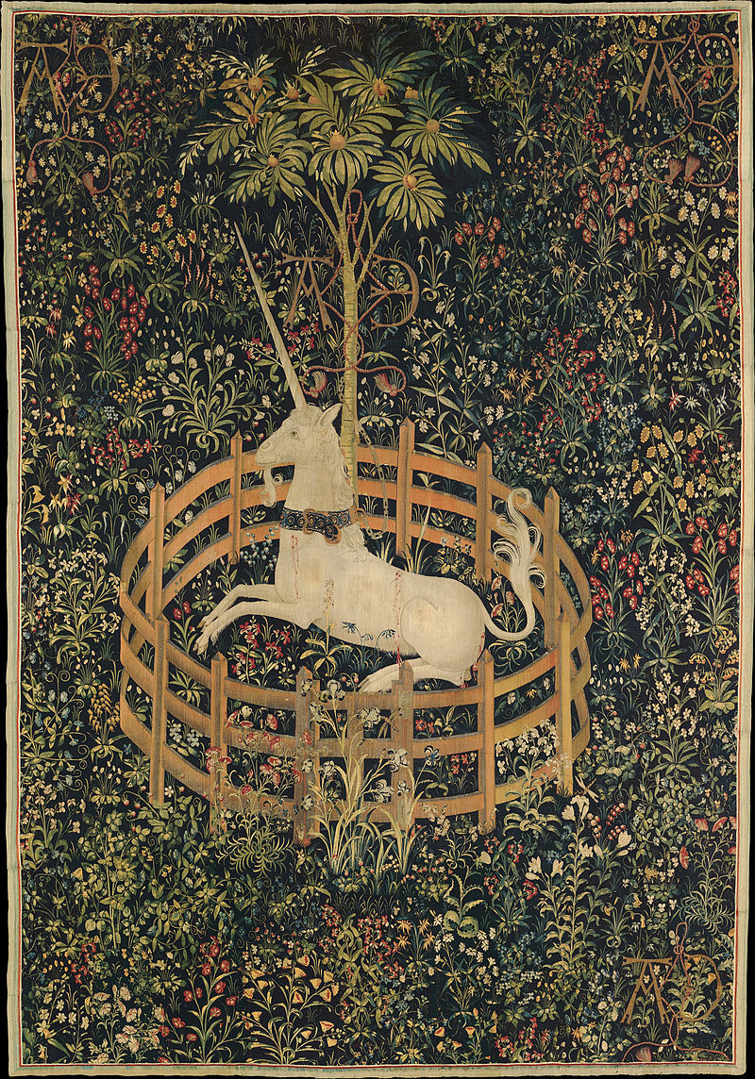
Tapestry Weaving
A tapestry is weft-faced weaving, in which all the warp threads are hidden in the completed work
Examples exist from ancient Greece
Tapestries were often used both as decoration and as insulation.
In Medieval Europe, decorative tapestry weaving entered a new stage of detail.
“The Unicorn in Captivity” is the last in a series of 7 tapestries known as the
The Hunt of the Unicorn, dating between 1495 and 1505.

Slide 5
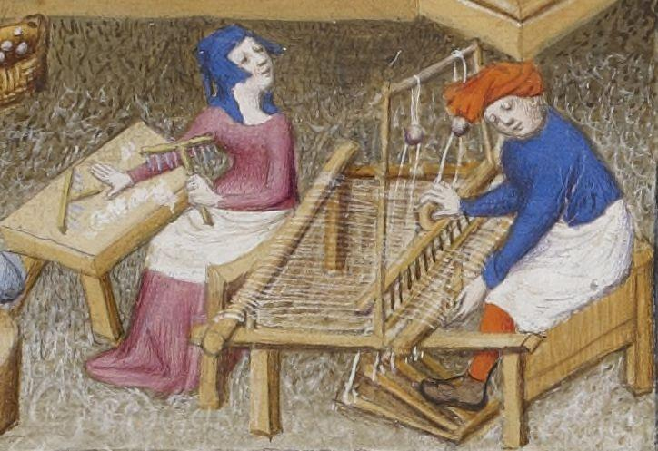
Looms
For centuries, weaving was usually completed via a loom by hand.
During the Middle Ages, weaving began to move away from family unit and into specialized workplaces.
The Industrial Revolution (1700s-1800s) brought steam and water powered looms and the invention of the fly shuttle.
Today, looms are entirely mechanized and nearly all woven cloth is manufactured by machine.
Illustration from Giovanni Boccaccio’s De Claris mulieribus, circa 1374

Slide 6
Texture--
The element of art that shows how an object looks and sometimes feels.
There are two kinds of texture: visual and tactile.

Slide 7
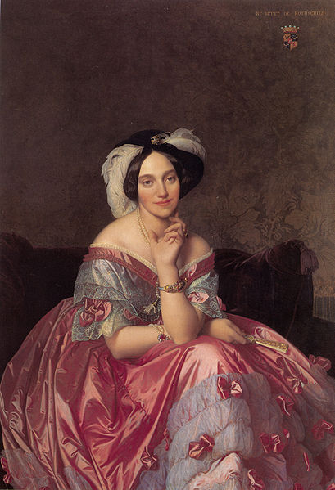
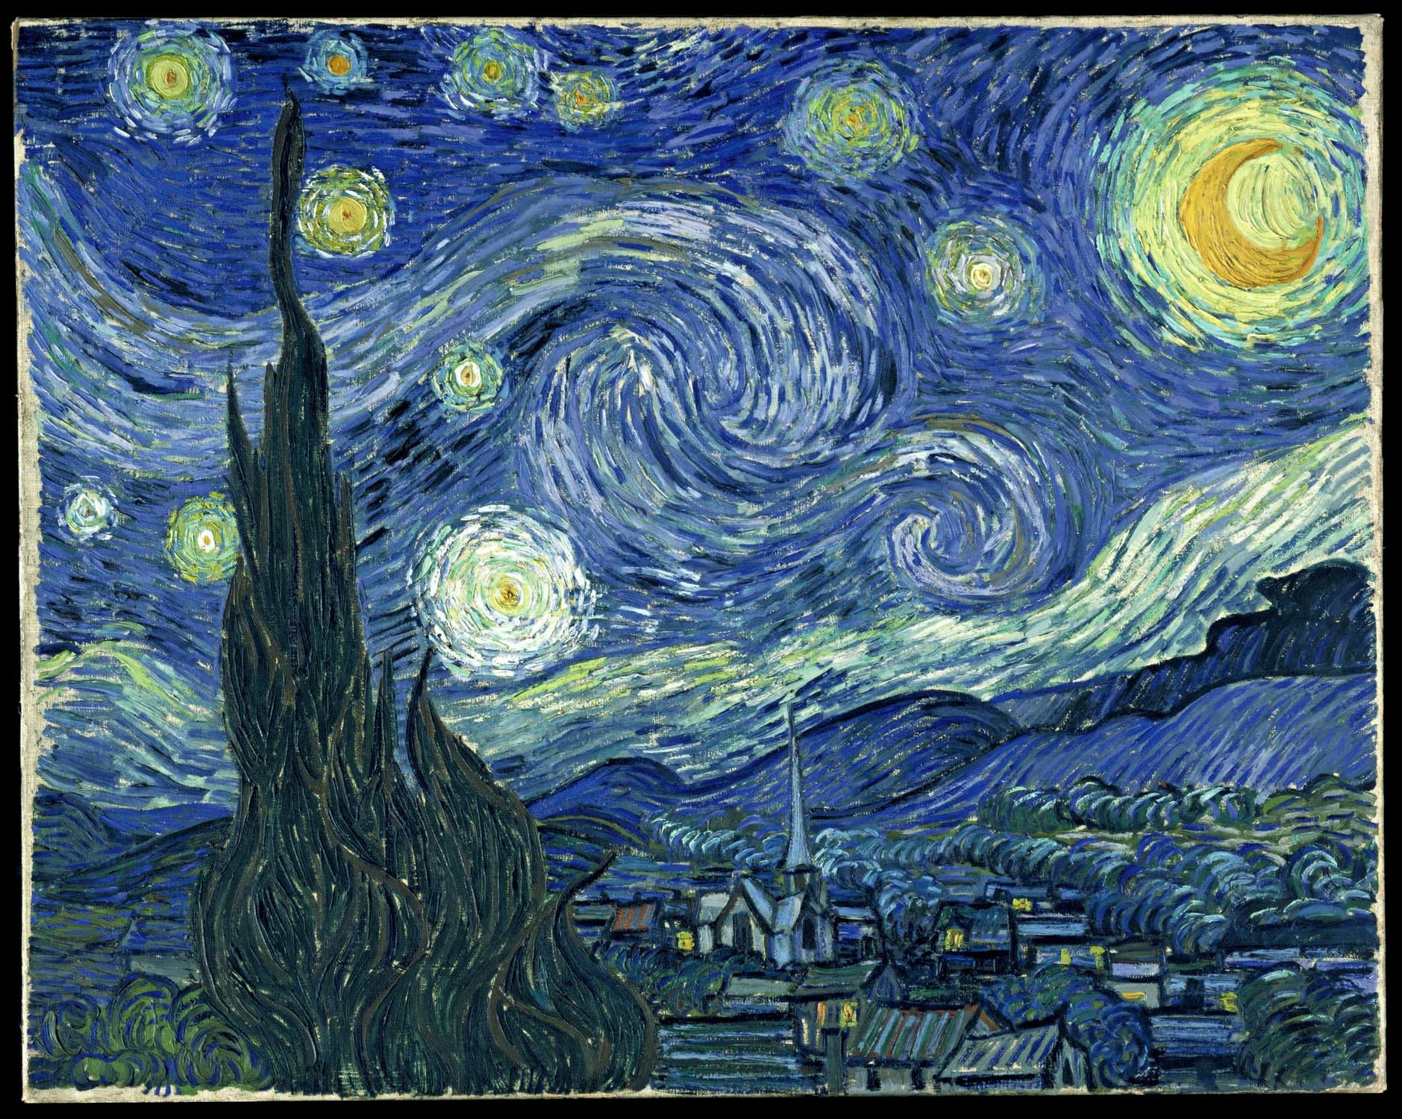
Visual Textures -- you can only see with your eyes
The illusion of how an object would feel if it could be physically touched...
Portrait of the Baronness James de Rothschild (1848) Jean Auguste Dominique Ingres
Starry Night (1889) Vincent Van Gogh

Slide 8
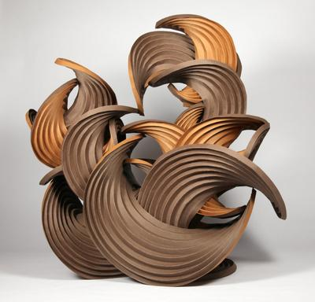
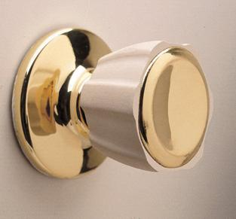
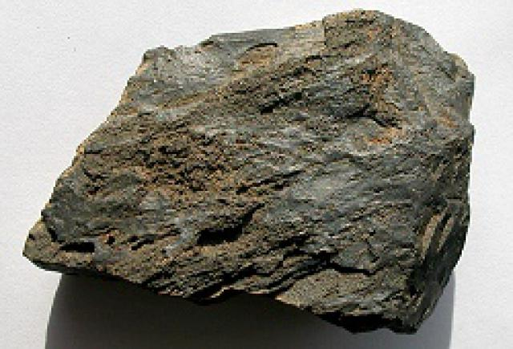
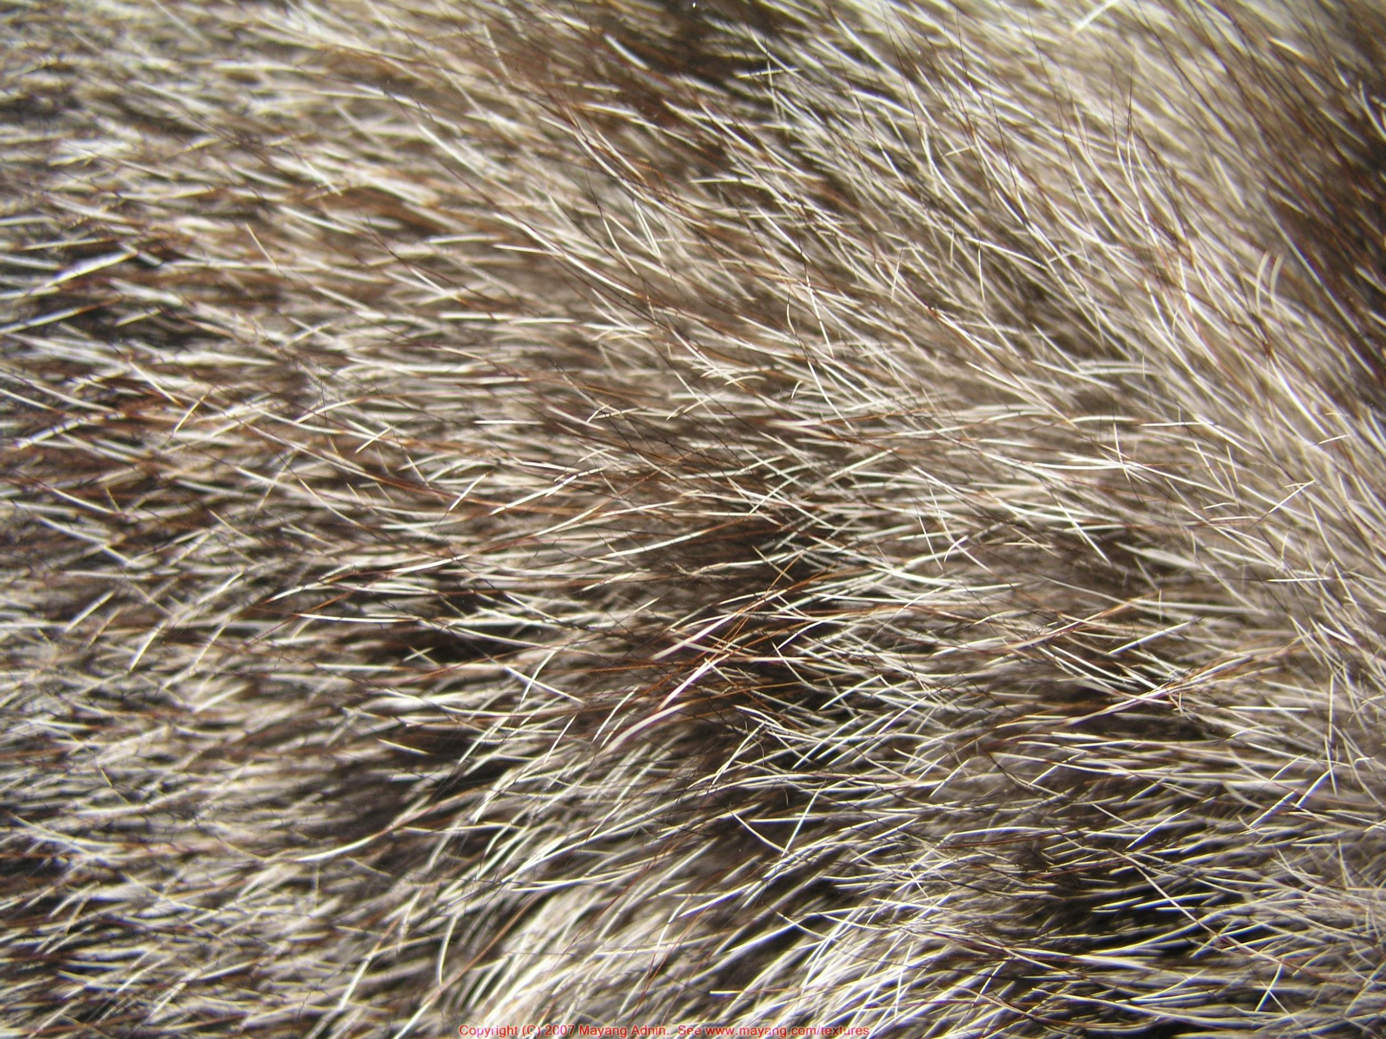
Tactile Textures -- you can both see and feel by touching
It can be physically touched and felt…
“Earthtone Series”
Curved Crease Sculpture, paper
(2012)
Erik Demaine & Martin Demaine

Slide 9
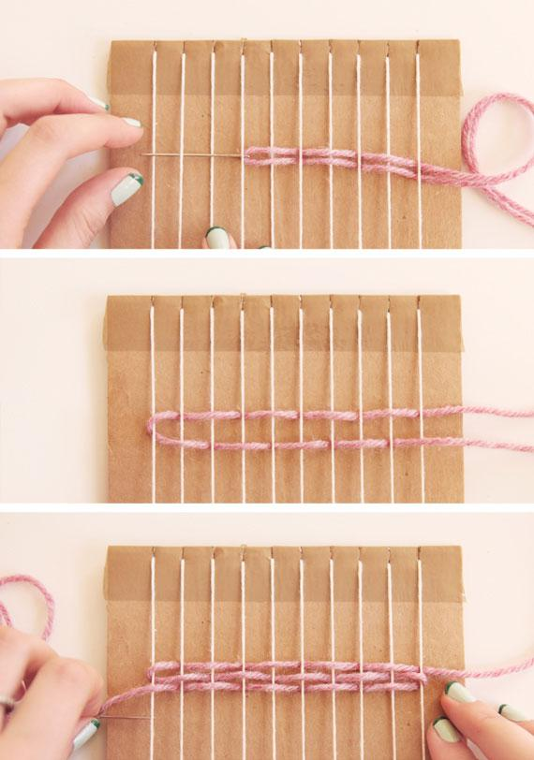
Project: woven wallhanging
Loom
Weave
Guide the yarn through the warp threads using an over-under pattern
Images by Clare McGibbon:
https://blog.etsy.com/en/learn-how-to-weave/

Slide 10
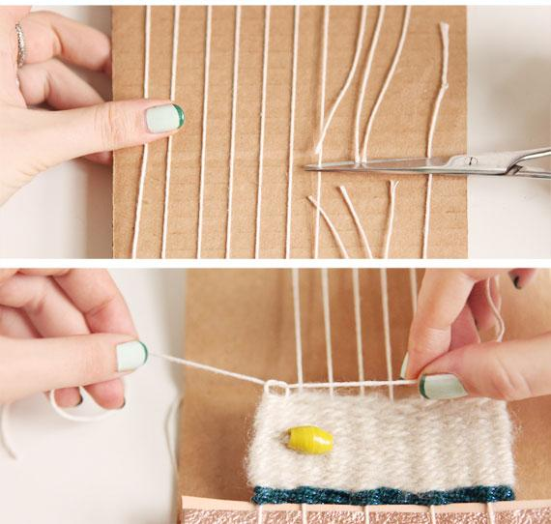
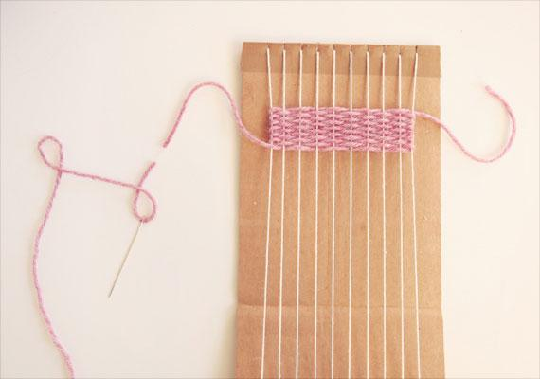
Finishing off....
When you’ve finished weaving, turn over the loom and cut the warp threads across the center.
Then take the warp threads to the front in pairs and tie a double knot to secure.
Images by Clare McGibbon:
https://blog.etsy.com/en/learn-how-to-weave/

