Slide 1
Texture
the feel of things

Slide 2
Texture
The element of art that shows how an object looks and sometimes feels.
There are two kinds of texture, tactile and visual.

Slide 3
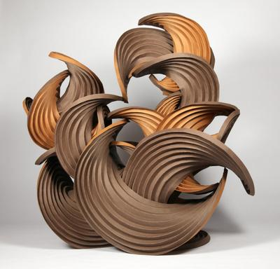
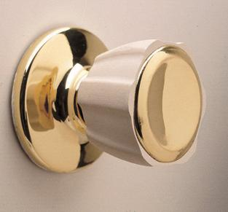
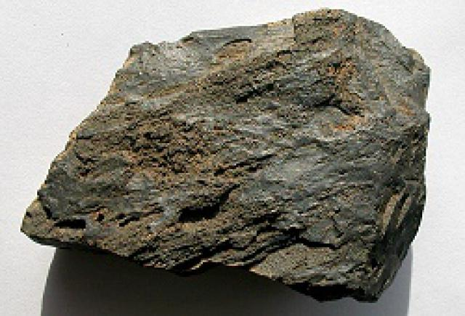
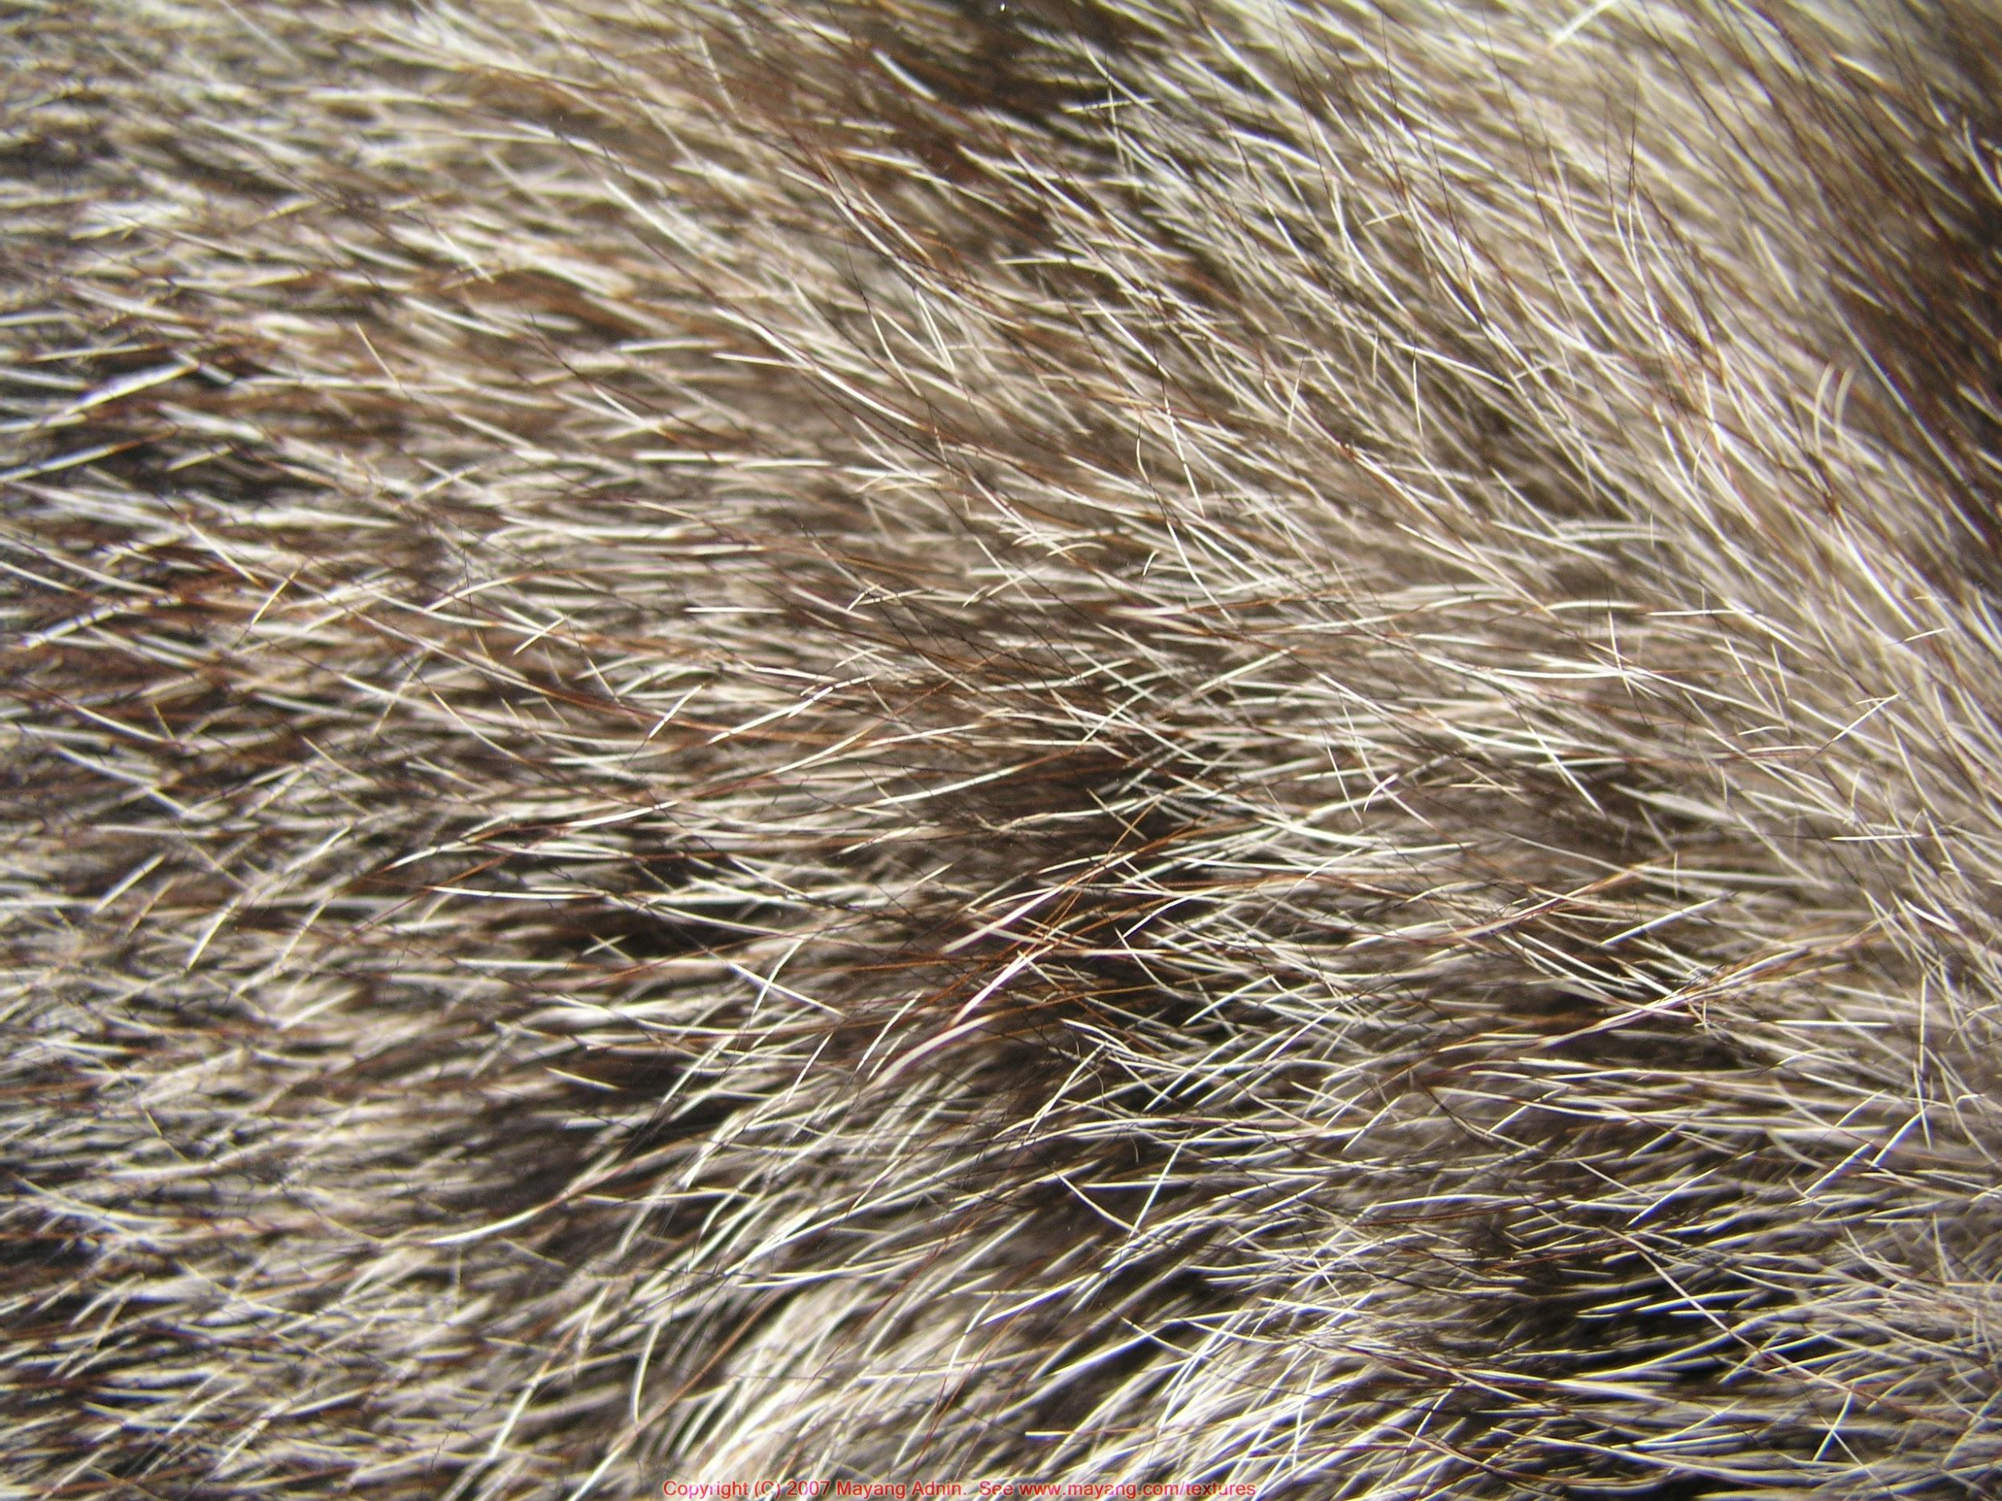
Tactile Textures -- you can both see and feel by touching
It can be physically touched and felt…
“Earthtone Series”
Curved Crease Sculpture, paper
(2012)
Erik Demaine & Martin Demaine

Slide 4
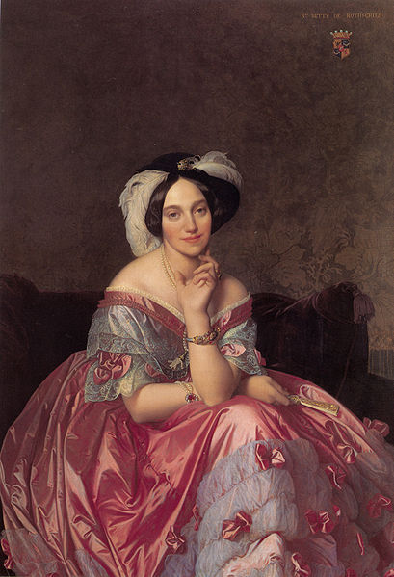
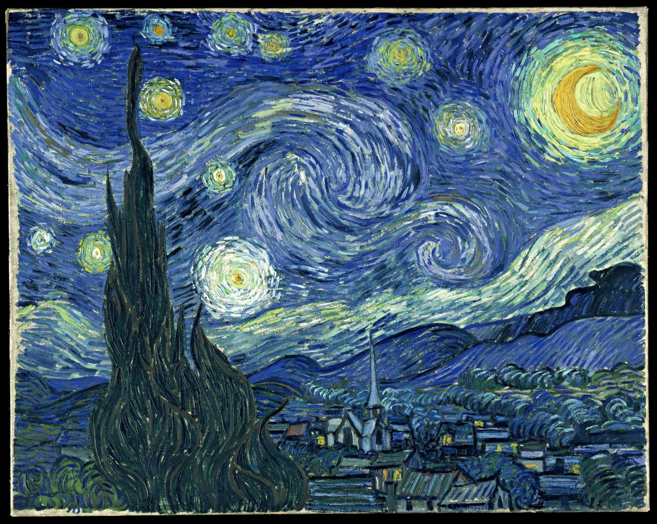
Visual Textures -- you can only see with your eyes
The illusion of how an object would feel if it could be physically touched...
Portrait of the Baronness James de Rothschild (1848) Jean Auguste Dominique Ingres
Starry Night (1889) Vincent Van Gogh

Slide 5
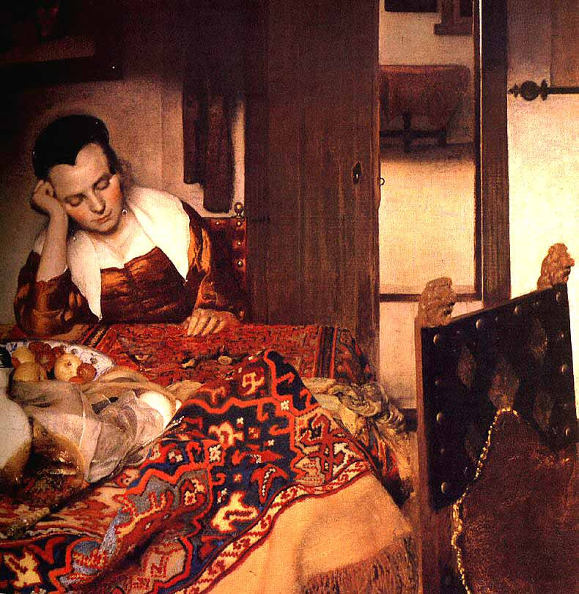
Girl Asleep
(1657)
Johannes Vermeer

Slide 6
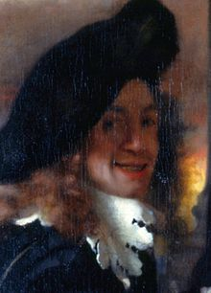
Johannes Vermeer (1632 -1675)
Dutch
Father an art dealer and when he died, Vermeer is thought to have taken over the business.
Painted very little over his lifetime.
Used very expensive pigments and paints which was very unusual for the time.
Preferred realistic subjects and painted in a photorealistic style.
Did not have much financial success with painting and died in debt.
His work was re-discovered 200 years after his death.
The Procuress (c. 1656), considered to be a self portrait by Vermeer.

Slide 7
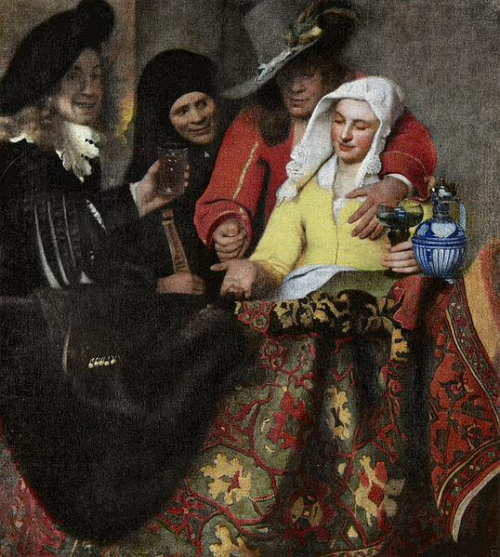
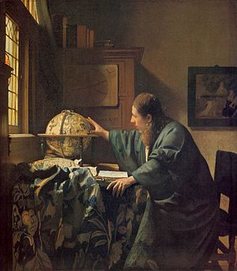
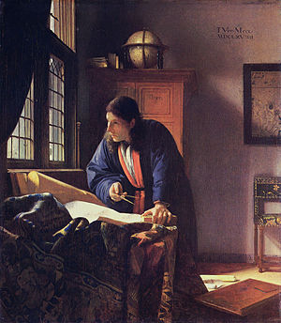
The only works actually signed by Vermeer...
The Geographer
(c. 1668-69)
The Procuress
(c. 1656)
The Astronomer
(c. 1668)

Slide 8
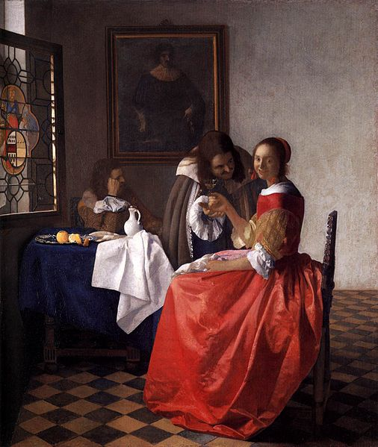
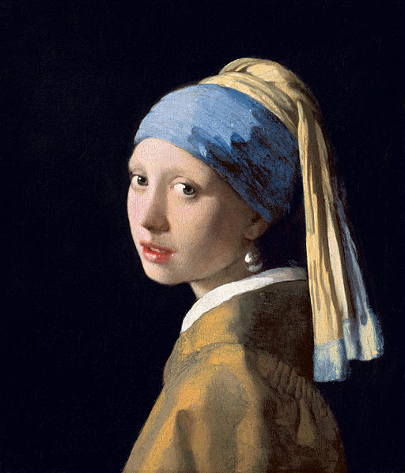
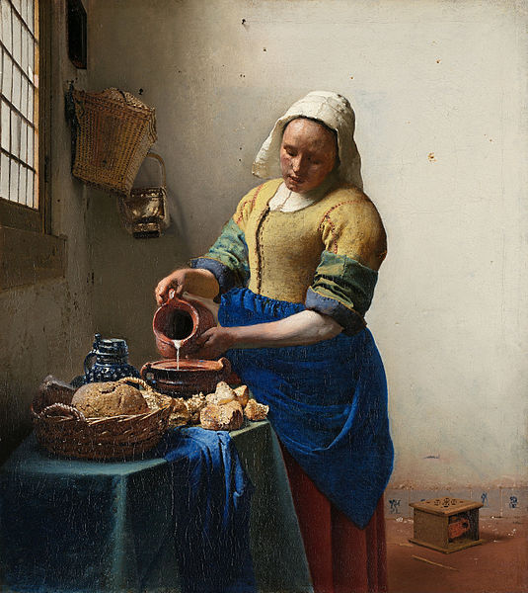
A few of Vermeer’s most well-known works...
A Lady and Two Gentlemen (c. 1659)
Girl with a Pearl Earring
(c. 1665)
The Milkmaid
(c. 1660)

Slide 9
Project: Texture Collage
Paper
Various textured materials
Glue + brush
Create a collage using a variety of different materials.
If you close your eyes,
do some things look different but feel the same?

