Slide 1
Symmetry

Slide 2
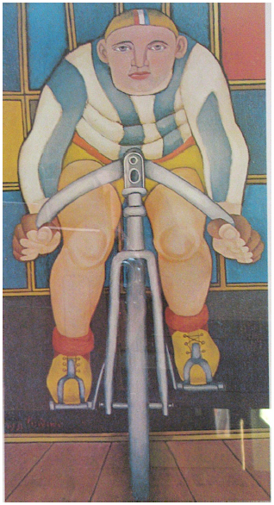
The Cyclist
(1951)
oil on canvas
Richard Lindner

Slide 3
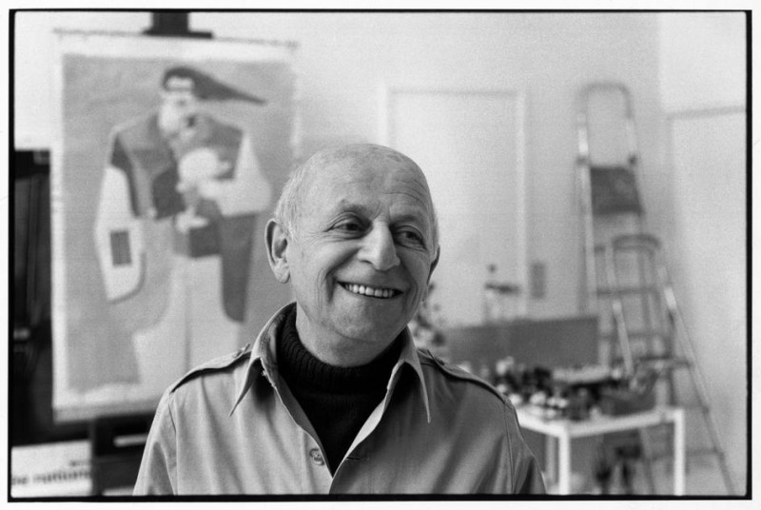
Richard Lindner
Born in Hamburg Germany on November 11, 1901. His mother was an American.
Studied music and piano, but later started painting.
1922 began at Nuremberg’s School of Fine and Applied Arts; later went to Munich’s Academy of Fine Arts.
Came to U.S. after being interned during World War II.
Made illustrations for various magazines.
Gave up illustrating and focused on painting and teaching.
Very successful artist.
Work characterized by bright colors, storytelling, humor.
Died April 16, 1978.
The Painter Richard Lindner, 1974.
© Henri Cartier-Bresson/Magnum Photos

Slide 4
Symmetry
the kind of formal balance when two halves of an object or composition “match” in colors, lines, and shapes producing mirror images

Slide 5
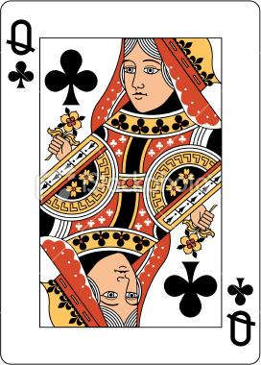
same on both sides...

Slide 6
Symmetry helps to create a sense of visual balance in a work.
Perfect Symmetry
vs.
Near Symmetry

Slide 7
Project: Paint Blob Symmetry
Write name on paper
Fold paper in half
Place blobs of paint on only one side of the fold
Fold paper closed and rub in circular motions
Open paper: Symmetry!
Cut construction paper pieces to add details-- whiskers, eyes, nose, legs, etc. Remember to continue working in symmetry...

