Slide 1
Shapes in Art

Slide 2
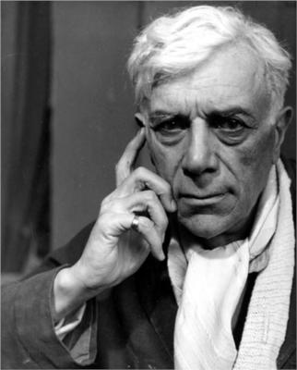
George Braque (1882-1963)
Born in France
Loved the outdoors (swimming, cycling)
Father was a house painter.
Friends with Pablo Picasso
With Picasso, he developed the Cubist style
Painter and sculptor

Slide 3
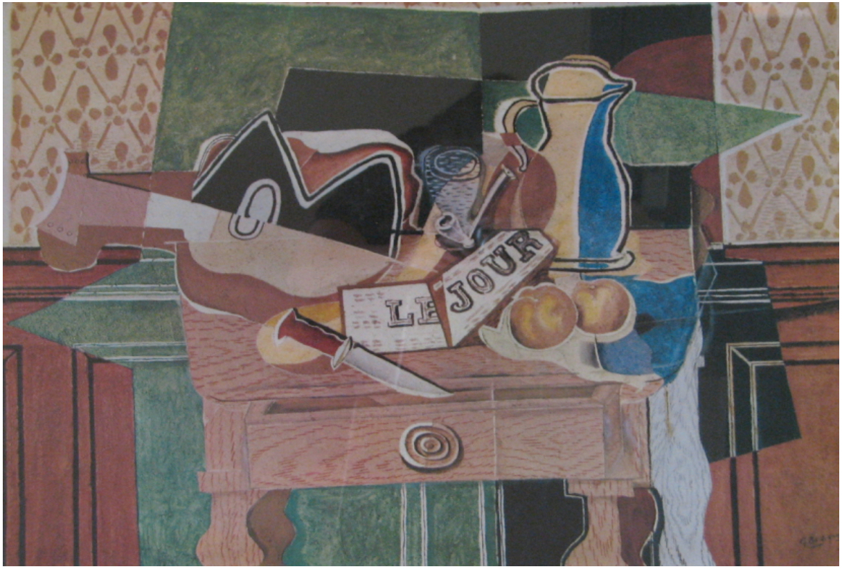
Le Jour by Georges Braque (1882-1963)

Slide 4
Examination
What does this painting show?
What shapes do you see?
Are there repeating shapes?
What primary colors do you see?
What secondary colors do you see?

Slide 5
Cubism
Taking familiar objects and recreating them using geometric shapes.
What familiar objects do you see in Le Jour?
What kinds of shapes do you see?

Slide 6
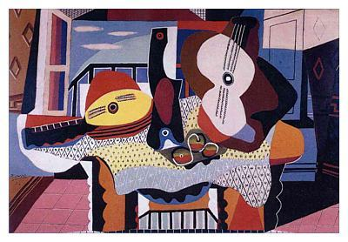
Other examples of Cubism:
Still Life with Mandolin and Guitar (1924)
by Pablo Picasso

Slide 7
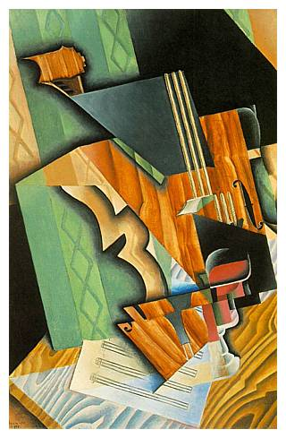
Still Life with Violin and Glass (1915)
by Juan Gris

Slide 8
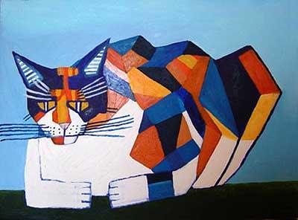
Cassie Thinking about Cubism by Philip Absolon

Slide 9
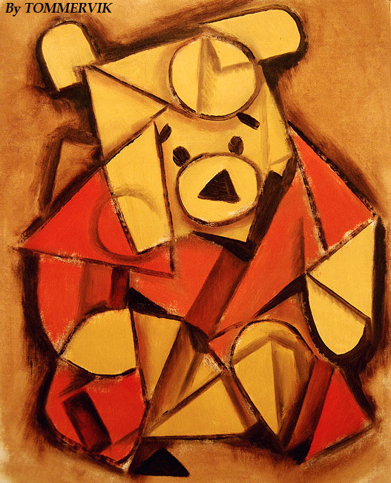
by Tommervik

Slide 10
Shape
an element of art that is a two-dimensional area that is defined in some way. A shape may have an outline around it or you may recognize it by its area.

Slide 11
Geometric shapes
precise shapes that can be described using mathematical formulas.
Examples:

Slide 12
Freeform shapes
also called organic shapes, are irregular and uneven shapes.
Their outlines may be curved, angular, or a combination of both.
Examples:

Slide 13
Project: Shape Collage
Assemble a composition using a variety of shapes.
Try different things!
Create a row
Overlap shapes
Use various sizes and colors of the same shape
When you are ready, glue the shapes to the paper.

