Slide 1
Lines
An exploration of
the use of line in art...

Slide 2
Line
a point in space that moves

Slide 3
Properties of lines
A line is one-dimensional and can vary in width, direction, and length.
Lines often define the edges of a form.
Lines can be horizontal, vertical, or diagonal, straight or curved, thick or thin.

Slide 4
Lines can show action, movement, and feeling...
jagged
straight
thick
light
dark
wavy
meandering
curved
thin
graceful
broken
forceful

Slide 5
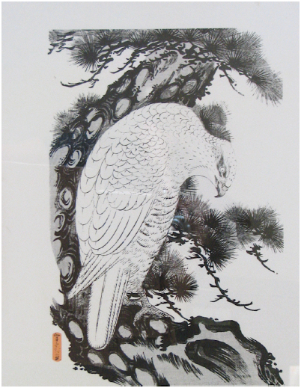
The Eagle
(late-eighteenth or early-nineteenth century) by Sekkyo

Slide 6
Thinking about the art...
Facts:
-- Woodblock print;
-- Original size: 20” H x 13.5” W
What do you see?
What kinds of lines do you see?
Why did the artist choose that line quality? What affect does it give?

Slide 7
Sawa Sekkyo (late-1700s-early-1800s)
Japanese
Studied under Tsutsumi Torin, but left the school and became an independent artist.
Best known for his landscapes and bird and animal studies.
Often printed entirely in black or blue ink.

Slide 8
An exploration of lines...
1. Write your name on back of paper.
2. On the front, use pencil to lightly draw a block letter of the first letter of your first name
3. When you are happy with the look of the letter, trace over the outside lines with permanent marker.
4. Fill in the space (either inside the letter or outside) with a variety of designs– think about:
LINE
SCALE
POSTIVE/
NEGATIVE

Slide 9
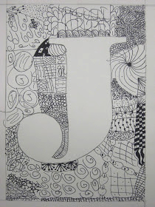
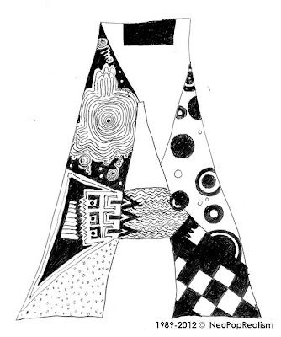
Some examples…

